Slide 1
Security Trading

Slide 2
Content
Order Type
Stock Analysis
Fundamental Analysis
Technical Analysis

Slide 3
Order Types
Limit Risks
Speed of Execution
Price Improvement
Discretion
Market Timing

Slide 4
Order Types Limit Risks
Basket
A group of individual orders that are saved in a single file and submitted as a package which diversify the risks.
Stop
A Stop order becomes a market order to buy or sell securities or commodities once the specified stop price is attained or penetrated.
A Sell Stop order is always placed below the current market price. It is typically used to limit a loss or protect a profit on a long stock position. A Buy Stop order is always placed above the current market price. It is typically used to limit a loss or protect a profit on a short sale.
Stop Limit
A Stop Limit order becomes a limit order once the specified stop price is attained or penetrated.
A STOP-LIMIT order eliminates the risk of a stop order where the investor is not guaranteed an execution price, but exposes the investor to the risk that the order may never be filled even though the stop price has been reached. The investor could "miss the market" in the security or commodity altogether.
Notes:
止损单(STOP ORDER)：这是一种当买方出价或卖方要价抵达预定价位时自动清仓的指令。
限价停损单 ( Stop-Limit Order ): 此种委托单结合了限价买单 ( Buy Limit Order ) 以及限价卖单 ( Sell Limit Order ) 二种形式。当股票达到一特定价格时，限价停损委托单便被使用。Limit order就包括限价买单 ( Buy Limit Order ) 以及限价卖单 ( Sell Limit Order ) 二种形式。

Slide 5
Order Types Speed of Execution
Market
A market order is an order to buy or sell an asset at the bid or offer price currently available in the marketplace.
Market If Touched
An MIT (market-if-touched) is an order to buy (or sell) an asset below (or above) the market. This order is held in the system until the trigger price is touched, and is then submitted as a market order. An MIT order is similar to a stop order, except that an MIT sell order is placed above the current market price, and a stop sell order is placed below.
Market On Open
A market order executed at the market's open at the market price.
Market On Close
A market order executed at the market's close at the market price.
Notes:
市价定单(Market Order)（又称市价委托）是按照当时可能是最好的价格立即（尽快）买进或卖出某一特定交割月份的一定数量外汇合同的定单，这种定单并不规定具体的成交价格只规定交割月份的合同数量
触及市价单 (MIT, Market if touched) 是一种设定成交前提的交易指令：一旦市价触及所设的价格,该指令自动变成市价单,即须按当时所能取得的最佳价格尽快成交. 经纪人接获这种交易指令,只要当天市价曾触及所设价格,即必须以市价完成交易,不得推诿因故无法成交.

Slide 6
Order Types Speed of Execution (cont.)
Pegged to Market
An order that is pegged to buy on the best offer and sell on the best bid.
VWAP
The VWAP for a stock is calculated by adding the dollars traded for every transaction in that stock ("price" x "number of shares traded") and dividing the total shares traded. A VWAP is computed from the open of the market to the market close, and is calculated by volume weighting all transactions during this time period.
Notes:
Pegged to Market: 盯住市场or挂钩市场被限定以最佳要价买入和以最佳出价卖出的定单。
VWAP - Best Efforts（交易量加权平均价格－最大努力） （交易量加权平均价格－最大努力） 该 IB 算法基于最大努力，在不超过用户定义的日交易量最大百分比的情况下，获得交易量 加权平均价格。
VWAP - Guaranteed（交易量加权平均价格定单） （交易量加权平均价格定单） 为帮助客户减少交易风险，IB 对大市值股票支持交易量加权平均价格。股票的 VWAP 按如 下方法计算：把该股票每笔交易的交易金额加起来（“价格”×“交易的股票数量”）并除以交 易的总股数。 交易量加权平均价格从开始的截止时点一直计算到结束的截止时点， 并根据对该时段内的所 以交易加权来计算。VWAP 价格由 Bloomberg 计算，在市场收盘后显示，并被保证执行。 默认情况下， 开始截止时点为从市场开盘到市场收盘的每分钟。 交易平台将自动地对下一分 钟截止时点提交的 VWAP 定单， 除非通过点击有效时间区域并使用时钟功能选择新时间来选 择了一个不同的开始截止时点。 能够通过使用到期时间区域的时钟功能来修改计算的结束截 止时点（默认为市场收盘时） 。

Slide 7
Order Types Price Improvement
Limit
A limit order is an order to buy or sell a contract at a specified price or better.
Limit If Touched
An LIT (limit-if-touched) is an order to buy (or sell) an asset below (or above) the market, at the defined limit price or better. This order is held in the system until the trigger price is touched, and is then submitted as a limit order. An LIT order is similar to a stop limit order, except that an LIT sell order is placed above the current market price, and a stop limit sell order is placed below.
Notes:
Limit-if-Touched（触及限价） 定单以指定限价或更好价格买入（或卖出）低于（或高于）市场价格的资产。 这种定单一直被持有在系统中，直到触发价格被触及，然后作为限价定单被提交。

Slide 8
Order Types Discretion
Discretionary
A Discretionary Order is a limit order for which you define a discretionary amount (which is added to or subtracted from the limit price) that increases the price range over which the order is eligible to execute. The original limit price is displayed to the market.
Hidden
A Hidden order (generally a large volume order) shows no evidence of its existence in either the market data or the deep book
Iceberg
An Iceberg order allows you to submit an order (generally a large volume order) while publicly disclosing only a portion of the submitted order.
Notes:
Discretion酌处权
Discretionary全权委托定单是一种限价定单， 您对其定义一个任意的金额 （将被添加到限价中或从限价中扣减） ，该金额会增大定单能够执行的价格范围。最初的限价被显示给市场。
Hidden 隐藏定单（通常是大交易量定单），既不在市场数据中也不在深层交易册中显示其存在。
Iceberg Order 冰山指令是把一笔大单分成很多个小单， 下达这些小单通常是使用程序化交易来实现， 这样 做的目的是为了隐藏其实际大单的数量。 例如：当参与者，如大型机构投资者，需要购买和出售证券投资组合的量非常大，他们可以 划分成很多小单，让公众看到每次只能发现一小部分的指令。好像是‘冰山一角’只是一个巨大的冰块质量的可见部分。 通过隐藏其大的规模， 冰山指令降低了由大幅度买卖股票带来的 价格波动。

Slide 9
Order Types Market Timing
All or None
An AON (all or none) order will remain at the exchange (or in the IB system) until the entire quantity is available to be executed.
Fill or Kill
A FOK (Fill or Kill) order must execute as a complete order as soon as it becomes available on the market, otherwise the order is canceled.
GTD
A GTD (Good-till-Date) order valid until the date specified.
GTC
A GTC (Good-till-Canceled) order is an order to buy or sell a security at a specific or limit price that lasts until the order is completed or cancelled. A GTC order will not be filled until the limit has been reached, no matter how many days or weeks it takes.
IOC
An IOC (Immediate or Canceled) order requires that all or part of the order be executed as soon as it is brought to the market, whereby the portion not executed is automatically canceled.
Notes:
All-or-None（全或无指令） 使用全或无（AON）属性的定单，只有当整个数量在特定的价格或更好价格可用时才将被执 行。定单将保持活动直到：整个数量在特定的价格（或更好）可用。或者定单被取消。
Fill-or-Kill 全数执行或立刻取消指令，将有效时间设置为全数执行或立刻取消（FOK） ，规定整个定单必须立刻执行或者被取消。
Good-till-Date/Time（到期/到时前有效指令） GTD（到期/到时前有效）有效时间让指定一个到期日期和时间，直到这之前定单都将继续 工作。设定该属性需要选定到期前有效（GTD）作为有效时间，在到期日期区域中输入一个 日期，并在到期时间区域中输入一个时间（如果需要该水平的细节） 。注意，如果只输入了 到期前有效的日期，未执行的定单将在指定日的市场收盘时取消。
Good-till-Canceled（取消前有效指令 一种使用取消前有效（GTC）作为有效时间的定单，将继续工作直到定单执行或被取消。
Immediate-or-Cancel 立刻执行或取消指令应用于定单的立刻执行或取消（IOC）有效时间命令定单任何未立刻执行的部分将被取消。

Slide 10
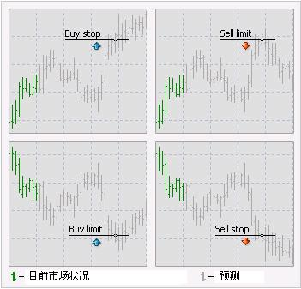
Order Samples: Stop VS. Limit
1、buy limit ：是跌到一个价位抢反弹。即行情正在下趺，你准备等它跌到期望的某个低位再买入，就可在那个位置挂一个Buy LImit。 2、buy stop ：是涨到一个价位追涨。即行情正在上升，你计划等它突破某个重要关口，再追买，就可在那个价位之上设一个Buy stop。
例如：当前价格是1.9000 Buy Limit at 1.8900 Buy Stop at 1.9500 Sell Limit at 1.9100 Sell Stop at 1.8900
Notes:
http://hi.baidu.com/arborwang/item/d133d63967dce048023edc20

Slide 11
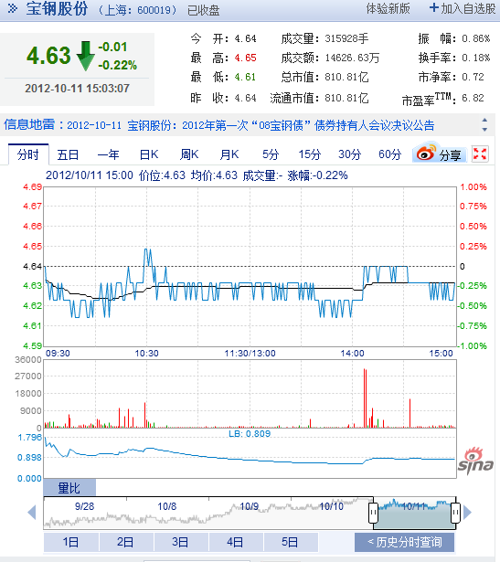
How to read Stock Quote
52W high & low
Stock
Ticker
Div Yield and % (div per shr/price per shr)
P/E ratio
volume (day vol. in hundreds)
Day high & low
Day close (last price) bold if 5% with prev cls
Net change

Slide 12
Analyzing Stocks

Slide 13
Price Changing
Stock prices change according to supply and demand. There are many factors influencing prices, the most important being earnings.
Earnings are the profit a company makes, and in the long run no company can survive without them.
Nobody really knows for sure why stock prices change.

Slide 14
Stock Investment Features
Long term
Clear investing goal and self-acceptance of risk
Emphasize the risk control and have accurate risk budget
Take eyes on the whole portfolio management
Large orders to affect the whole market
…

Slide 15
Two Analysis Models
Fundamental Analysis (Buying a Business)
fundamental analysis is a technique that attempts to determine a security’s value by focusing on underlying factors that affect a company's actual business and its future prospects.
It maintains that markets may mis-price a security in the short run but that the "correct" price will eventually be reached. Profits can be made by trading the mispriced security and then waiting for the market to recognize its "mistake" and reprice the security.
Technical analysis (Buying the Numbers)
It maintains that all information is reflected already in the stock price,
Investors' emotional responses to price movements lead to recognizable price chart patterns.
Their price predictions are only extrapolations from historical price patterns.

Slide 16
Fundamental Analysis

Slide 17
Approach
Top-down
Investor starts his analysis with global economics, and then narrows his search down to regional/industry analysis. Finally he narrow his search to the best business in that area.
Bottom-up
Investor starts his analysis with a specific business.

Slide 18
Factors
Company’s History and Current Status
Earning
Sales
Management
Governance
Balance Sheet/Income Statement/Cash-flow Statement
Strength of Products in Marketplace
…
Industry Status
Market Shares
Industry Growth
Competition
Regulation
…

Slide 19
Measurements
Price/Book Ratio(PB)
Price/Free Cash Flow Ratio
Price/Earning Ratio (P/E)
Price/Sales Ratio
Revenue/Share
Operation Income/Share
EPS (Earnings Per Share)
Equity/Share
…
Notes:
EPS(每股盈余)=盈余/流通在外股数，传统的每股收益指标计算公式为：每股收益=期末净利润÷期末总股本。EPS为公司获利能力的最后结果。
市盈率是最常用来评估股价水平是否合理的指标之一，由股价除以年度每股盈余(EPS）得出

Slide 20
Equity Pricing Models
P/E Ratio Pricing Model
Dividend Discount Model (DDM)
Capital Asset Pricing Model (CAPM)
Arbitrage pricing theory (APT)
Notes:
P/E Ratio Pricing Model: 市盈率定价模型 发行价格=每股收益×发行市盈率
威廉姆斯（Williams）1938年提出了公司（股票）价值评估的股利贴现模型（DDM）,为定量分析虚拟资本、资产和公司价值奠定了理论基础，也为证券投资的基本分析提供了强有力的理论根据。

Slide 21
Technical Analysis

Slide 22
Principle
Price Discounts Everything 价格反映一切
Prices move in trends 价格变动是有趋势
History repeats itself 历史会重演
** Not Just for Stock
Notes:
价格包容一切。
价格以趋势方式演变。
历史会重演。

Slide 23
市场行为包容一切
“市场行为包容一切”是技术分析的基石。
技术分析者认为，任何可能影响股票、期货市场价格的因素———基础的、政治的、心理的或其他——实际上都反映在其价格之中，而价格变化必定反映供求关系。技术分析者只研究价格变化就足够了，而不必研究造成价格变动的内在因素。
技术分析者所使用的图表等工具之所以发生作用，是因为这些工具本身如实地描述了市场参与者的行为，使我们能够把握市场参与者对市场的反应，从而把握市场的未来趋势。

Slide 24
价格以趋势方式演变
“趋势”概念是技术分析的核心。
技术分析者认为，市场确有趋势可循，而且当前的市场趋势有势能或惯性，只有当它走到趋势的尽头，它才会掉头反向。
研究价格图表的全部意义，就是要辩识出趋势发展的早期形态，以便顺应趋势进行交易。事实上，大多数技术分析理论在本质上就是顺应趋势，即以判定、追随市场的既成趋势为目的。

Slide 25
历史会重演
技术分析和市场行为与人类心理学有关，证券投资不过是一种追求利润的行为，不论是昨天、今天或明天，这个目的都不会改变。
在这种心理状态下，市场交易行为将趋于一定的模式，由此导致历史重演，即过去出现过的价格趋势和变动方式，今后会不断出现。
由于这些图表型态在过去表现良好，我们就假设它在将来表现一样良好。投资者就可以分析通过过去的价格变动资料来预测未来的价格走势。

Slide 26
Candle Stick
Ｋ线（Candlesticks），又称为阴阳线、卦线、蜡烛线、热狗线、酒井线等。
据说起源于日本德川幕府时代，大阪米市一位叫酒井的商人用它来记录一天或一周当中市场行情的价格波动变化。

Slide 27
Candle Stick Sample
最高价
上影线
最高价
收盘价
开盘价
柱状实体
开盘价
下影线
收盘价
最低价
最低价

Slide 28
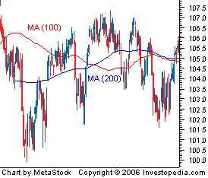
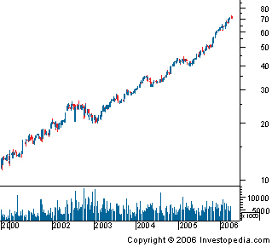
Trend Definition
A trend the general direction in which a security or market is headed
Trends are not always easy to see
The trend is your friend

Slide 29
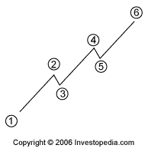
Trend Types
UpTrend
DownTrend
Sideways/Horizontal Trends
Notes:
横盘/横向趋势

Slide 30
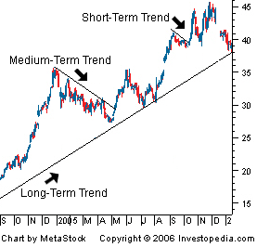
Trend Terms
The longer the trend, the more important
Weekly charts or daily charts spanning a five-year period are used to identify long-tern trends
Daily data charts are best used when analyzing both intermediate and short-term trends.

Slide 31
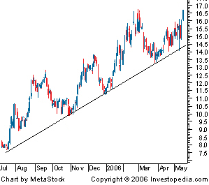
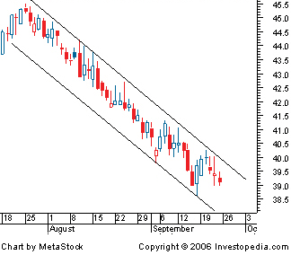
Trend Lines and Trend Channels
Trend Line
Trend Channel

Slide 32
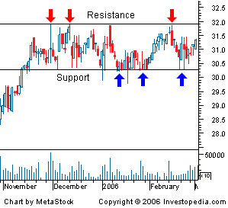
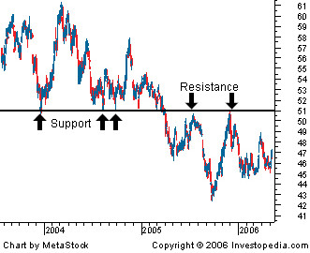
Trend--Support/Resistance
Reversal

Slide 33
Reversal
Reversal
After a long decline, start to reverse…very similar to ‘first sunny day’ in previous slide
Rally
Correction

Slide 34
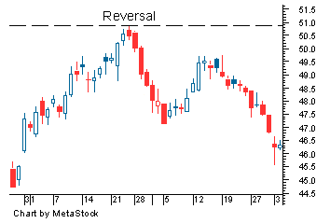
Reversal
A change in the direction of a price trend. On a price chart, reversals undergo a recognizable change in the price structure. An uptrend, which is a series of higher highs and higher lows, reverses into a downtrend by changing to a series of lower highs and lower lows. A downtrend, which is a series of lower highs and lower lows, reverses into an uptrend by changing to a series of higher highs and higher lows.
Notes:
http://www.investopedia.com/terms/r/reversal.asp#axzz28oLuOPxf

Slide 35
Volume is important
Volume is simply the number of shares or contracts that trade over a given period of time.
The higher the volume, the more active the security.
Volume should move with the trend.
Volume confirm Chart Patterns
Volume Precedes Price

Slide 36
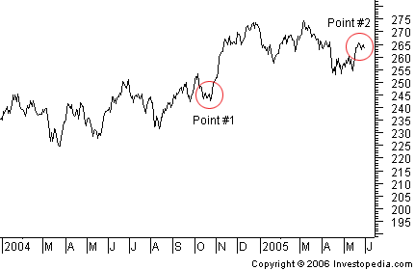
Chart Definition
Charts are similar to the charts that you see in any business setting. A chart is simply a graphical representation of a series of prices over a set time frame

Slide 37
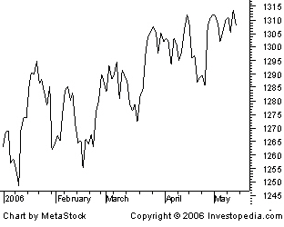
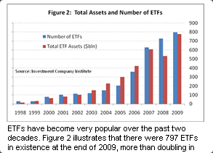
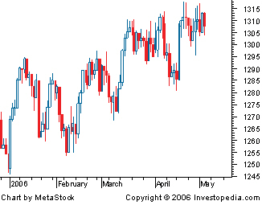
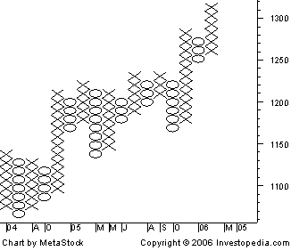
Chart Types
Line Chart
Bar Chart
Candle Chart
Point and Figure Chart

Slide 38
Chart Pattern
Reversal Chart Patterns: Head and Shoulders and Inverted Head and Shoulders
Reversal Chart Patterns: Triple and Double Tops and Bottoms
Reversal Chart Patterns: V-Reversal Pattern
Continuation Chart Patterns: Triangles
Notes:
Reversal Chart Patterns 反转形态
头肩形
三重顶，底
二重顶，底
V型

Slide 39
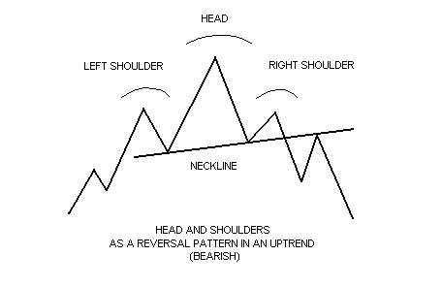
Chart Pattern– Head and Shoulders
Head and shoulder (can be inverted too)

Slide 40
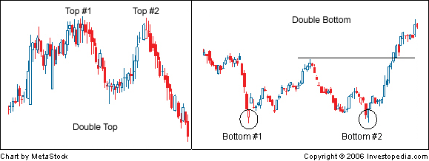
Chart Pattern– Double Tops and Bottoms

Slide 41
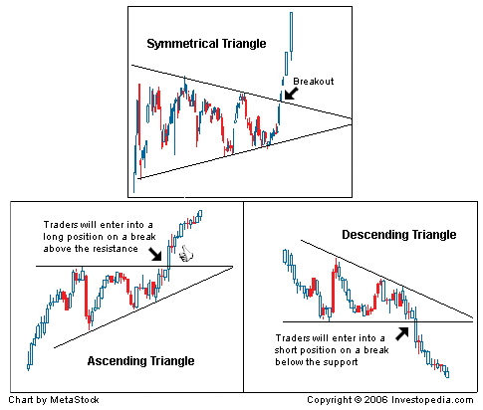
Chart Pattern– Triangles

Slide 42
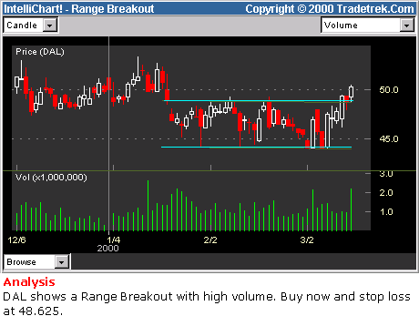
Range Breakout(区间突破)
The figure below shows an example of a typical Range Breakout pattern
The figure below shows an example of a typical Range Breakout pattern
The trading strategy for a Range Breakout is just the opposite that of Head-and-Shoulders: it indicates a strategy of buying as the stock breaks the upper range line with larger-than-average volume, and continuing to hold until the stock has risen a distance comparable to the height of the range. If the price goes down instead, one should stop losses as it penetrates the upper range line.
Notes:
http://www.tradetrek.com/education/tech_tra/tech_trading_strategy04.asp

Slide 43
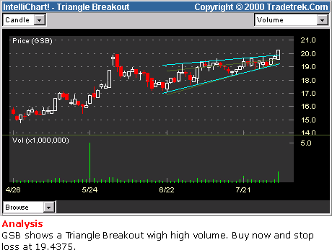
Triangle breakout
This is the famous Triangle Breakup pattern, a strong buy signal. In the past two months the stock price shown has consolidated with declining amplitude and volume. At present, it breaks out with high volume, signaling a possible new up trend.
Notes:
http://www.tradetrek.com/education/tech_tra/tech_trading_strategy05.asp

Slide 44
Cup with a handle (杯柄形态)
Cup with a handle
According to tradetrek's extensive and rigorous historical tests, the Cup-With-A-Handle breakup pattern is the most reliable technical buy signal. The figure below shows a typical example
According to tradetrek's extensive and rigorous historical tests, the Cup-With-A-Handle breakup pattern is the most reliable technical buy signal. The figure below shows a typical example:
The strategy is to buy the stock as the price breaks up with larger than average volume, then cut losses if it drops back to the pre-breakup level. If it goes up as expected, this pattern calls for successively raising the stop levels, giving the trade a chance to capture most of the up potential. According to Tradetrek's extensive experience and historical testing, the opposite pattern of theCup-With-A-Handle does not work nearly as well.

Slide 45
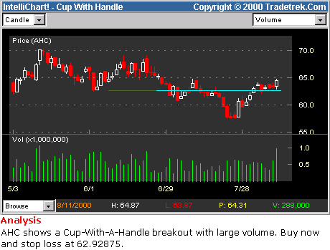
Cup with a handle

Slide 46
Moving Average
Most chart patterns show a lot of variation in price movement which makes it difficult get an idea of a security's overall trend.
A moving average is the average price of a security over a set amount of time. By plotting a security's average price, the price movement is smoothed out.
Simple Moving Average takes the sum of all of the past closing prices over the time period and divides the result by the number of prices used in the calculation.
More complicated Moving Averages can be calculated by adding more factors

Slide 47
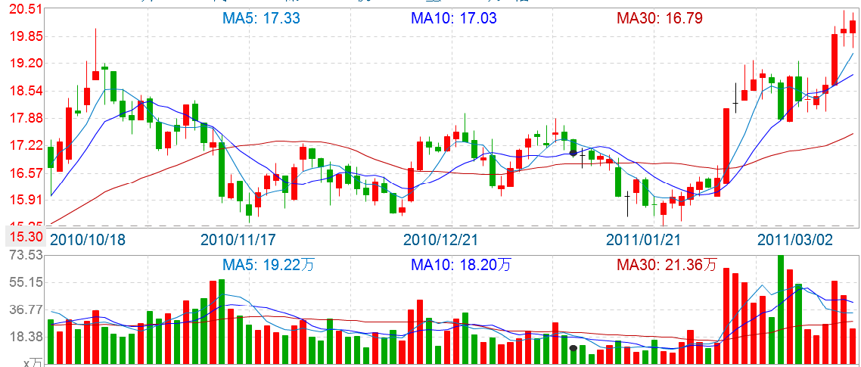
Moving Average Sample

Slide 48
Indicator Definition
Indicators are calculations based on the price and the volume of a security
There are two main types of indicators: leading and lagging.
A leading indicator precedes price movements, which gives a predictive quality
A lagging indicator is a confirmation tool, which follows price movement.
Indicators confirm each other
…

Slide 49
Indicators
Bollinger Bands
Candle Stick Trend
Breakout
Momentum
Money Flow
Relative Strength Index (RSI)
…

Slide 50
Indicator Sample – RSI
Formula:
RSI = 100 - 100 / (1 + U / D)
Where:
U - average value of the positive price changes (Up close) over a period;
D - average value of the negative price changes (Down close) over a period; The most frequently used time periods are 8 and 14.
RSI indicator is considered overbought if it is above the 70 level, and oversold if it is below the 30 level. RSI signals:
If the indicator is below the 50 line, then the market is considered to be bearish;
If above the 50 level, then the market is considered to be bullish;
If the indicator is around the 50 line it signals that the market is flat;
Bullish divergence / bearish convergence – the main signal of the trend weakness;
Under flat conditions exit from the overbought (oversold) territory is a signal to sell (buy);
Different types of the trend analysis can be used to analyze RSI: trend lines, support / resistance levels, chart reversal and continuation patterns.

Slide 51
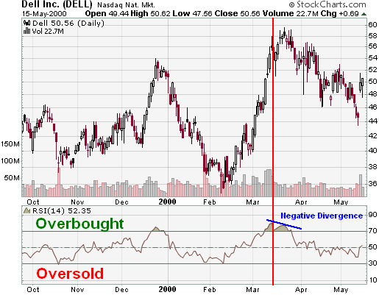
Indicator Sample – RSI (cont.)
Overbought/Oversold
Divergences
Centerline Crossover
The DELL example shows a number of extreme readings as well as a negative divergence. In Oct-99, RSI reached oversold for a brief moment to mark the low around 38. The next extreme reading (overbought) occurred after a large advance that peaked in Dec-99. RSI reached overbought levels in late Dec-99 and moved below 50 by the second week of Jan-00. The next oversold reading occurred in Feb. for another brief moment and marked the low around 35. By the end of Feb-00, RSI moved back above 50 and into overbought territory in March. A negative divergence formed in March and marked the high in the upper fifties.

